Slide 1
AR TAUFIA AZIZ
Regno : 2021503565
Final Project
3/21/2024 Annual Review

Slide 2
Music generator
3/21/2024 Annual Review

Slide 3


AGENDA This project aims to create a music generation system using Long Short-Term Memory (LSTM) neural networks. The model architecture will consist of multiple LSTM layers, followed by dropout and dense layers, optimized for music generation tasks. The model will be trained on a large dataset of music sequences, with a focus on achieving coherent and diverse outputs. Performance will be evaluated using various metrics to ensure the generated music meets the desired quality standards. The project will conclude with a discussion of results, addressing challenges, and suggesting future improvements.
3/21/2024 Annual Review

Slide 4

PROBLEM STATEMENT
Creating music with artificial intelligence is becoming popular, but it can be tricky to make it sound good. Many AI-generated music pieces feel repetitive, lack variety, or don't have much emotion. To fix this, we need a better approach that can understand complex patterns in music. This project uses Long Short-Term Memory (LSTM) neural networks to generate music, aiming to make the AI's music more interesting and emotionally rich. The goal is to create an AI that can produce music that feels creative and engaging.

Slide 5

PROJECT OVERVIEW This project explores the use of Long Short-Term Memory (LSTM) neural networks for music generation. It focuses on building a model capable of learning and generating sequences in music, aiming to create compositions that are complex, varied, and emotionally resonant. The approach involves training the model on existing music to capture underlying patterns and structures. By fine-tuning the LSTM architecture and optimizing with specific parameters, the project seeks to produce AI-generated music that can stand alongside human compositions. Ultimately, the goal is to contribute to the development of AI music generation that is both innovative and artistically satisfying.

Slide 6

WHO ARE THE END USERS?
Music Producers and Composers: Professionals in the music industry who can use AI-generated music as a creative tool or inspiration for their work.
Artists and Performers: Musicians looking for new and innovative compositions to perform or incorporate into their own pieces.
Content Creators: People who create multimedia content, such as YouTubers, filmmakers, or game developers, who may require background music for their projects.
Music Enthusiasts: General music lovers interested in exploring AI-generated compositions for personal enjoyment or curiosity.

Slide 7
YOUR SOLUTION AND ITS VALUE PROPOSITION
Innovative Composition: The project offers a way to generate unique and innovative musical compositions, providing artists with fresh content to inspire their work.
Time Efficiency: By automating music creation, it significantly reduces the time required for manual composition, allowing music producers to focus on refining and customizing the output.
Cost-Effectiveness: AI-generated music can be more affordable compared to hiring composers or licensing existing music, providing a budget-friendly solution for content creators.
Versatility and Adaptability: The model's flexibility allows for generating various music genres, accommodating a broad range of end-users from different creative fields.

Slide 8
THE WOW IN YOUR SOLUTION
Innovative Music Generation: The project uses Long Short-Term Memory (LSTM) networks to generate unique music compositions, demonstrating AI's capacity for creative output. The flexibility of LSTM allows for various musical styles and genres to be explored.
Fast and Customizable: The model's design enables rapid music generation, reducing the time needed for manual composition. It also provides customization options, allowing users to control and influence the generated music's style, tempo, and other characteristics.
Cross-Industry Applications: The generated music can be used in multiple fields, such as entertainment, gaming, advertising, and education, showing the project's versatility. This adaptability showcases the broad potential and value of AI-driven music generation.

Slide 9
MODELLING
Sequential Model: The project uses a sequential architecture, indicating that the neural network processes data in a linear sequence from the input to the output layers.
LSTM Layers: The primary model structure is based on Long Short-Term Memory (LSTM), a type of recurrent neural network (RNN) known for its ability to maintain context and understand sequential data. This allows the model to process musical sequences and generate new ones.
Dense Layers: In addition to the LSTM layers, the model includes dense layers to perform additional computations and transform the LSTM outputs into the desired format for generating new music. These layers often include a SoftMax activation function to produce a probability distribution over the possible outputs.

Slide 10
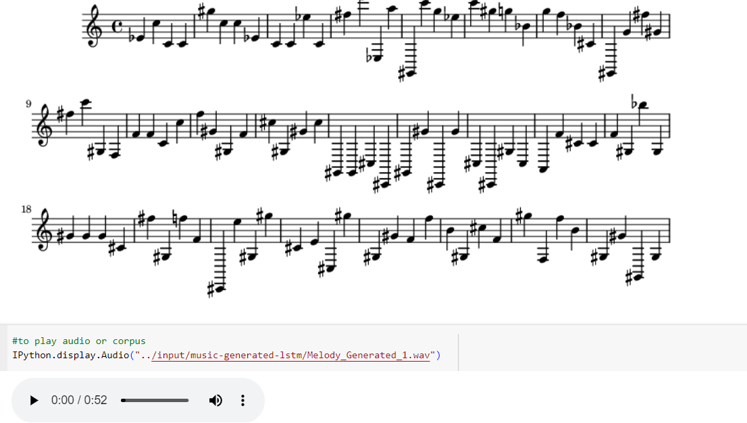
RESULTS

